Slide 1


304185C Unit 6: Graphics Programming & File Handling
TE E&TE

Slide 2
Syllabus
Graphics class, Introduction to AWT packages, Handling events on AWT components, Introduction to Swing package, components and containers.
Managing input/output files: Concept of streams, Stream Classes, Byte stream, Character stream, Using Stream, creation of files, reading or writing characters / bytes, Concatenating and buffering files, Random access files.

Slide 3
Graphics Class in JAVA
public abstract class Graphics extends Object
The Graphics class is the abstract base class for all graphics contexts that allow an application to draw onto components that are realized on various devices, as well as onto off-screen images.
A Graphics object encapsulates state information needed for the basic rendering operations that Java supports.

Slide 4
Graphics Class
This state information includes the following properties:
The Component object on which to draw.
A translation origin for rendering and clipping coordinates.
The current clip.
The current color.
The current font.
The current logical pixel operation function (XOR or Paint).
The current XOR alternation color (setXORMode(java.awt.Color))

Slide 5
Java AWT
Java AWT (Abstract Window Toolkit) is an API to develop Graphical User Interface (GUI) or windows-based applications in Java.
Java AWT components are platform-dependent i.e. components are displayed according to the view of operating system. AWT is heavy weight i.e. its components are using the resources of underlying operating system (OS).
The java.awt package provides classes for AWT API such as TextField, Label, TextArea, RadioButton, CheckBox, Choice, List etc.

Slide 6
Java AWT is Platform Independent
Java AWT calls the native platform calls the native platform (operating systems) subroutine for creating API components like TextField, ChechBox, button, etc.
For example, an AWT GUI with components like TextField, label and button will have different look and feel for the different platforms like Windows, MAC OS, and Unix. The reason for this is the platforms have different view for their native components and AWT directly calls the native subroutine that creates those components.
In simple words, an AWT application will look like a windows application in Windows OS whereas it will look like a Mac application in the MAC OS.

Slide 7
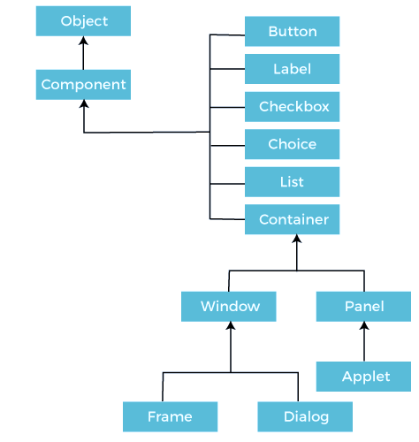
Java AWT Hierarchy
https://www.javatpoint.com/java-awt

Slide 8
Component Class
The Component class is the superclass of all components.
A component class can be linked with a page, components of web applications. Component is the graphical representation of an Object.
Types of Components in Component Class
Container
Button
Label
Checkbox
Choice
List
All these components are present in java.awt package. We can import each of the components individually i.e., import java.awt.Button, import java.awt.Container etc.

Slide 9
Java AWT Controls
Container: The Container is a component in AWT that can contain another components like buttons, textfields, labels etc. The classes that extends Container class are known as container such as Frame, Dialog and Panel.
Window: The window is the container that have no borders and menu bars. You must use frame, dialog or another window for creating a window.
Panel: The Panel is the container that doesn't contain title bar and menu bars. It can have other components like button, textfield etc.
Frame: The Frame is the container that contain title bar and can have menu bars. It can have other components like button, textfield etc.

Slide 10
Useful Methods of Component Class
Method | Description
public void add(Component c) | Inserts a component on this component.
public void setSize(int width,int height) | Sets the size (width and height) of the component.
public void setLayout(LayoutManager m) | Defines the layout manager for the component.
public void setVisible(boolean status) | Sets the visibility of a component to visible or not. If it sets to true, then the component will be visible in the output else if it sets to false or not defined component won’t be visible in the output.

Slide 11
AWT UI Elements
Label - A Label object is a component for placing text in a container.
Button - This class creates a labeled button.
Check Box - A check box is a graphical component that can be in either an on (true) or off (false) state.
Check Box Group - The CheckboxGroup class is used to group the set of checkbox.
List - The List component presents the user with a scrolling list of text items.
Text Field - A TextField object a text component that allows for the editing of a single line of text.
Text Area - A TextArea object is a text component that allows for the editing of a multiple lines of text.
Choice - A Choice control is used to show pop up menu of choices. Selected choice is shown on the top of the menu.

Slide 12
AWT UI Elements
Canvas - A Canvas control represents a rectangular area where application can draw something or can receive inputs created by user.
Image - An Image control is superclass for all image classes representing graphical images.
Scroll Bar - A Scrollbar control represents a scroll bar component in order to enable user to select from range of values.
Dialog - A Dialog control represents a top-level window with a title and a border used to take some form of input from the user.
File Dialog - A FileDialog control represents a dialog window from which the user can select a file.

Slide 13
Java Event Handling
Event:
Change in the state of an object is known as event i.e., event describes the change in state of source.
Events are generated as result of user interaction with the graphical user interface components.
For example, clicking on a button, moving the mouse, entering a character through keyboard, selecting an item from list, scrolling the page are the activities that causes an event to happen.
Types of Events: The events can be broadly classified into two categories:
Foreground Events
Background Events

Slide 14
Types of Events
Foreground Events:
The events which require direct interaction of user.
They are generated as consequences of a person interacting with the graphical components in Graphical User Interface.
For example, clicking on a button, moving the mouse, entering a character through keyboard, selecting an item from list, scrolling the page etc.
Background Events:
The events that require the interaction of end user are known as background events.
Operating system interrupts, hardware or software failure, timer expires, an operation completion are the examples of background events.

Slide 15
Event Handling
Event Handling is the mechanism that controls the event and decides what should happen if an event occurs.
This mechanism have the code which is known as event handler that is executed when an event occurs.
Java Uses the Delegation Event Model to handle the events. This model defines the standard mechanism to generate and handle the events.
The Delegation Event Model has the following key participants namely:
Source
The source is an object on which event occurs.
Source is responsible for providing information of the occurred event to it's handler.

Slide 16
Event Handling
Listener:
It is also known as event handler.
Listener is responsible for generating response to an event.
From java implementation point of view the listener is also an object.
Listener waits until it receives an event.
Once the event is received, the listener process the event and then returns.

Slide 17
Steps in Event Handling
The User clicks the button, and the event is generated.
The object of concerned event class is created automatically and information about the source and the event get populated with in same object.
Event object is forwarded to the method of registered listener class.
The method is now gets executed and returns.

Slide 18
Java Adapter Classes
Java adapter classes provide the default implementation of listener interfaces.
The adapter classes are found in java.awt.event, and javax.swing.event packages.
Working with Color, and Font.
Working with Color:
Java supports color in a portable, device independent fashion.
The AWT color system allows you to specify any color you want.
Color is encapsulated by the Color class. The most used constructors are:
Color (int red, int green, int blue)
Color (int rgbValue)
Color (float red, float green, float blue)

Slide 19
Working with Color
The first constructor takes three integers that specify the color as a mix of red, green, and blue.
These values must be between 0 and 255.
Example: new Color (255, 100, 100); // light red
The second color constructor takes a single integer that contains the mix of red, green, and blue packed into an integer.
The integer is organized with red in bits 16 to 23, green in bits 8 to 15, and blue in bits 0 to 7
Example: int newRed = (0xff000000 | (0xc0 << 16) | (0x00 << 8) | 0x00);
Color darkRed = new Color(newRed);
The final constructor, Color (float, float, float), takes three float values (between 0.0 and 1.0) that specifies the relative mix of red, green, and blue.

Slide 20
Setting the Current Graphics Color
By default, graphics objects are drawn in the current foreground color.
We can change this color by calling the Graphics method setColor() - void setColor (Color newColor);
Here, newColor specifies the new drawing color.
We can obtain the current color by calling getColor() - Color getColor();
Working with Fonts:
The AWT supports multiple type fonts.
Fonts are encapsulated by the Font class.

Slide 21
Creating and Selecting a Font
To select a new font, you must first construct a Font object that describes that font.
One Font constructor has this general form - Font(String fontName, int fontStyle, int pointSize);
Here, fontName specifies the name of the desired font.
To use a font that you have created, you must select it using setFont(), which is defined by Component.
It has this general form - void setFont(Font fontObj);
Here, fontObj is the object that contains the desired font.

Slide 22
Java AWT Examples
To create simple AWT example, you need a frame. There are two ways to create a GUI using Frame in AWT.
By extending Frame class (inheritance)
By creating the object of Frame class (association)

Slide 23
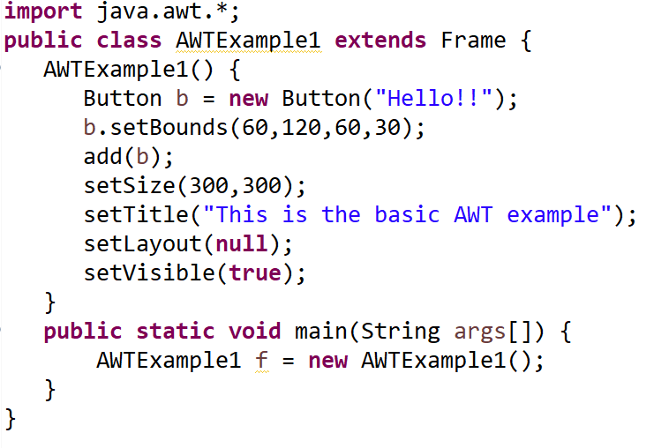
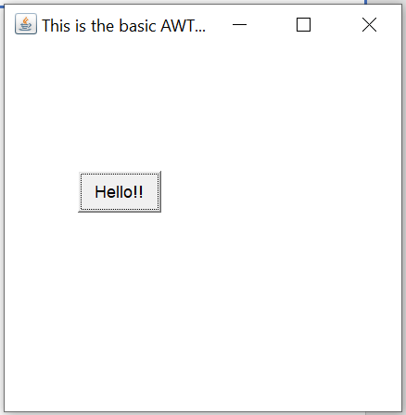
AWT Example by Inheritance

Slide 24
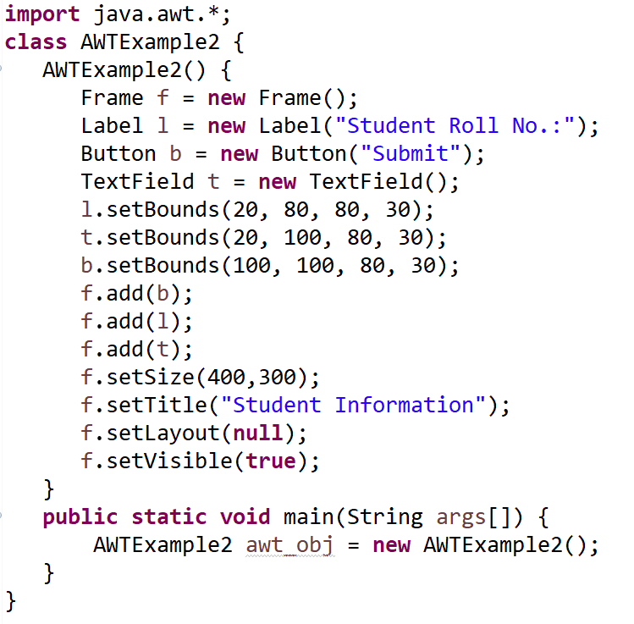
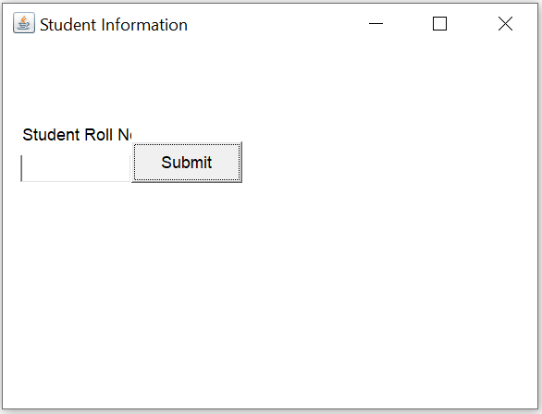
AWT Example by Association

Slide 25
Introduction to Swing
Swing is a Java Foundation Classes [JFC] library and an extension of the Abstract Window Toolkit [AWT].
Swing offers much-improved functionality over AWT, new components, expanded components features, excellent event handling with drag and drop support.
Swing has about four times the number of User Interface [UI] components as AWT and is part of the standard Java distribution.
By today’s application GUI requirements, AWT is a limited implementation, not quite capable of providing the components required for developing complex GUIs required in modern commercial applications.
The AWT component set has quite a few bugs and really does take up a lot of system resources when compared to equivalent Swing resources.
Netscape introduced its Internet Foundation Classes [IFC] library for use with Java.
Its Classes became very popular with programmers creating GUIs for commercial applications.

Slide 26
Features of Swing
Swing is a Set of API (API- Set of Classes and Interfaces).
Swing is Provided to Design a Graphical User Interfaces.
Swing is an Extension library to the AWT (Abstract Window Toolkit).
Includes New and improved Components that have been enhancing the looks and Functionality of GUIs.
Swing can be used to build (Develop) the Standalone swing GUI Apps, Servlets And Applets.
It Employs model/view design architecture.
Swing is more portable and more flexible than AWT, the Swing is built on top of the AWT.
Swing is entirely written in Java.
Java Swing Components are Platform-independent and the Swing Components are lightweight.
Swing Supports Pluggable look and feels and Swing provides more powerful components such as tables, lists, Scrollpanes, Colourchooser, tabbedpane, etc.

Slide 27
Features of Swing Class
Pluggable look and feel
Uses MVC architecture
Lightweight Components
Platform Independent
Advance features such as JTable, JTabbedPane, JScollPane etc
Java is a platform-independent language and runs on any client machine, the GUI look and feel, owned and delivered by a platform specific O/S, simply does not affect an application’s GUI constructed using Swing components.

Slide 28
Lightweight Components: Starting with the JDK 1.1, its AWT supported lightweight component development. For a component to qualify as lightweight, it must not depend on any non-Java [O/s based) system classes. Swing components have their own view supported by Java’s look and feel classes.
Pluggable Look and Feel: This feature enables the user to switch the look and feel of Swing components without restarting an application. The Swing library supports components look and feel that remains the same across all platforms wherever the program runs. The Swing library provides an API that gives real flexibility in determining the look and feel of the GUI of an application

Slide 29
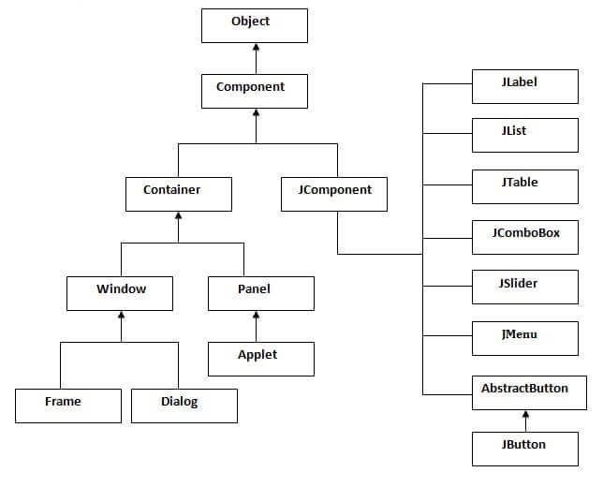
Swing Classes Hierarchy

Slide 30
AWT vs Swing
Java AWT | Java Swing
AWT components are heavyweight. | Swing components are lightweight.
AWT doesn't support pluggable look and feel. | Swing supports pluggable look and feel.
AWT provides less components than Swing. | Swing provides more powerful components such as tables, lists, scrollpanes, colorchooser, tabbedpane etc.
AWT doesn't follow MVC (Model View Controller) where model represents data, view represents presentation and controller acts as an interface between model and view. | Swing follows MVC.

Slide 31
Java Swing Examples
There are two ways to create a frame:
By creating the object of Frame class (Association)
By extending Frame class (Inheritance)

Slide 32
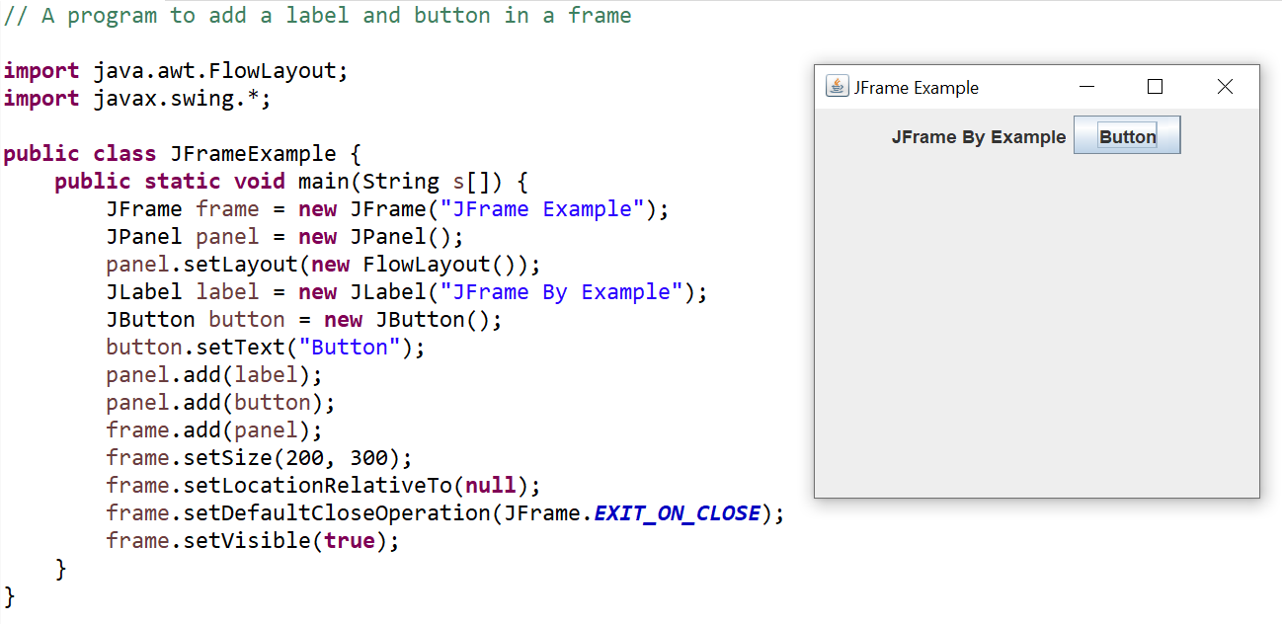
JFrame Example

Slide 33
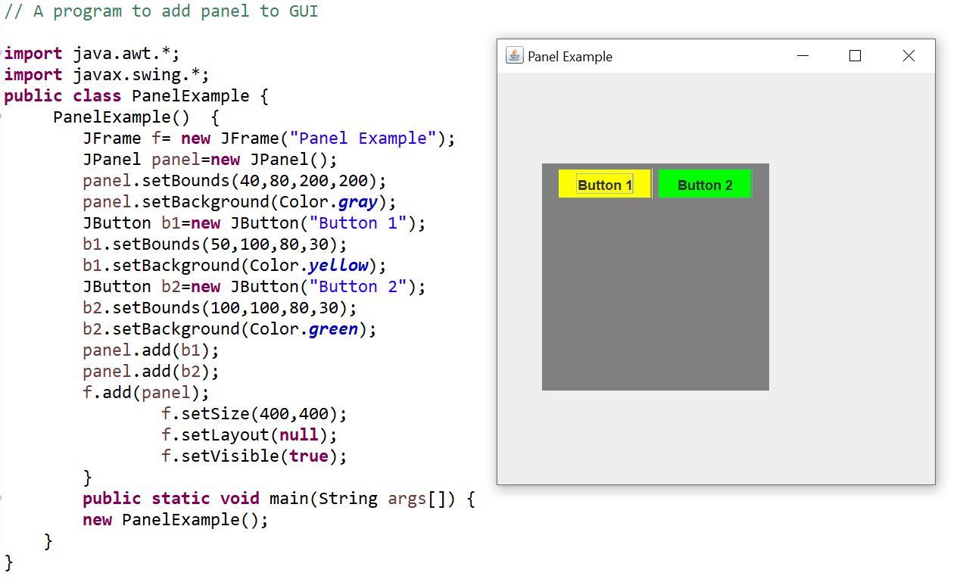
JPanel Example

Slide 34
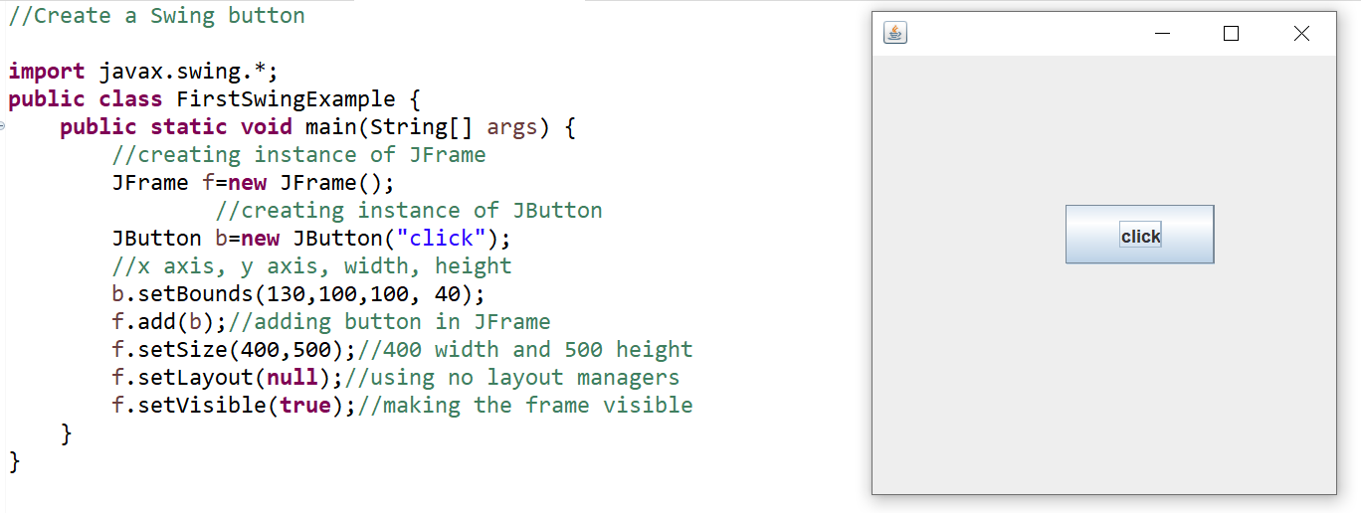
Swing Example

Slide 35
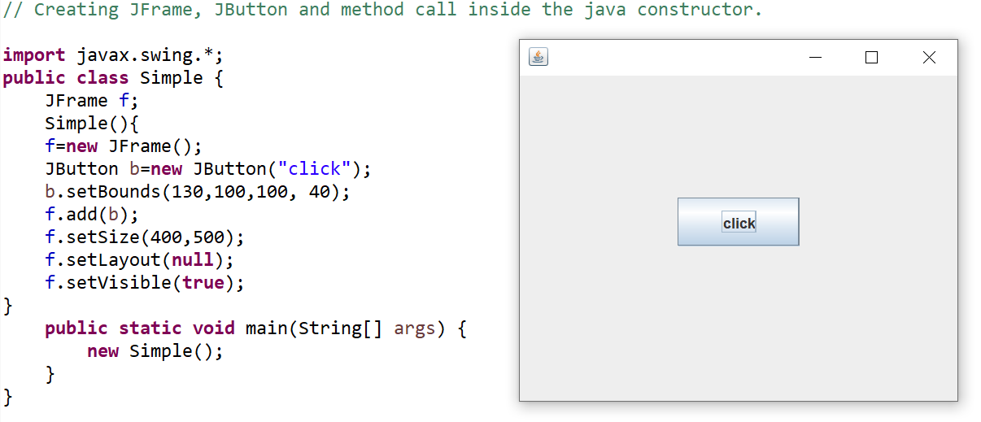
JFrame and JButton in Constructor

Slide 36
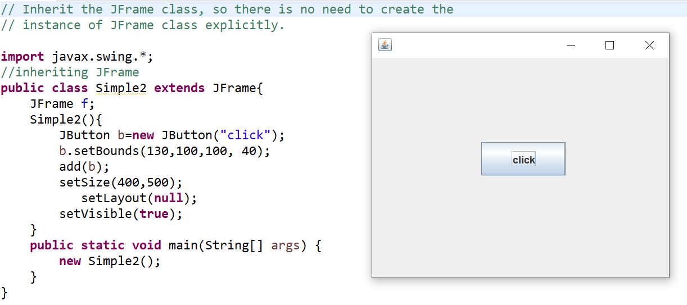
Inheriting JFrame Class

Slide 37
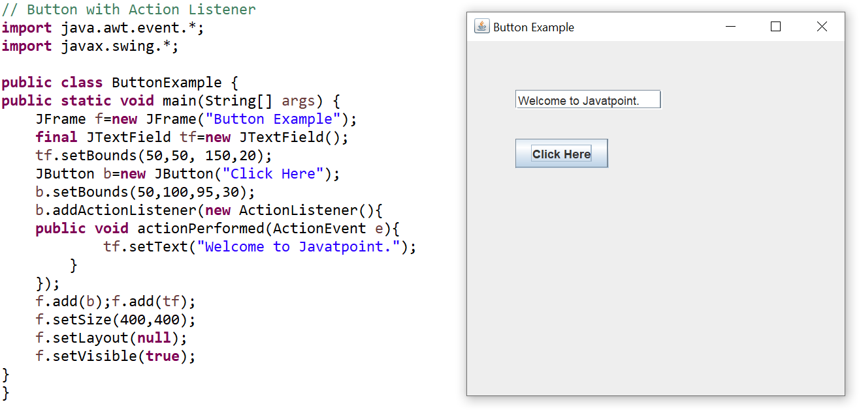
JButton Example

Slide 38
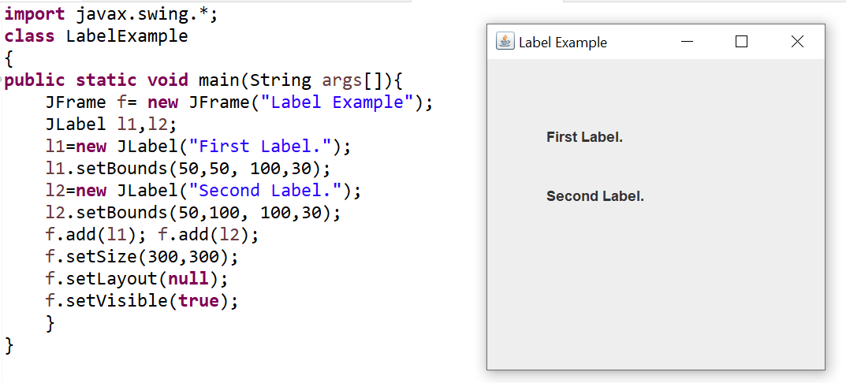
JLabel Example

Slide 39
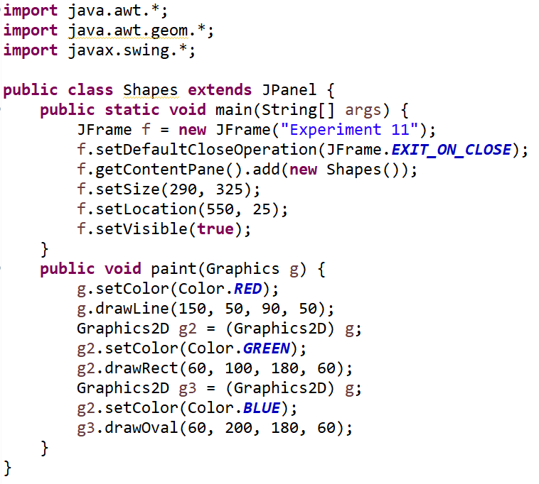
Drawing Geometrical Shapes

Slide 40
File Handling
In Java, file handling is done with File Class.
The File Class is inside the java.io package. The File class can be used by creating an object of the class and then specifying the name of the file.
File Handling is an integral part of any programming language as file handling enables us to store the output of any program in a file and allows us to perform certain operations on it.
In simple words, file handling means reading and writing data to a file.

Slide 41
Streams in Java
In Java, a sequence of data is known as a stream.
This concept is used to perform I/O operations on a file.
There are two types of streams :
Input Stream
Output Stream

Slide 42
Input Stream
The Java InputStream class is the superclass of all input streams.
The input stream is used to read data from numerous input devices like the keyboard, network, etc.
InputStream is an abstract class, its subclasses are used to read data.
There are several subclasses of the InputStream class, which are:
AudioInputStream
ByteArrayInputStream
FileInputStream
FilterInputStream
StringBufferInputStream
ObjectInputStream

Slide 43
Creating an InputStream
InputStream obj = new FileInputStream();
We can create an input stream from other subclasses as well as InputStream.

Slide 44
Methods of InputStream
Method | Description
read() | Reads one byte of data from the input stream.
read(byte[] array)() | Reads byte from the stream and stores that byte in the specified array.
mark() | It marks the position in the input stream until the data has been read.
available() | Returns the number of bytes available in the input stream.
markSupported() | It checks if the mark() method and the reset() method is supported in the stream.
reset() | Returns the control to the point where the mark was set inside the stream.
skips() | Skips and removes a particular number of bytes from the input stream.
close() | Closes the input stream.

Slide 45
Output Stream
The output stream is used to write data to numerous output devices like the monitor, file, etc.
OutputStream is an abstract superclass that represents an output stream.
OutputStream is an abstract class, its subclasses are used to write data.
There are several subclasses of the OutputStream class:
ByteArrayOutputStream
FileOutputStream
StringBufferOutputStream
ObjectOutputStream
DataOutputStream
PrintStream

Slide 46
Creating an OutputStream
OutputStream obj = new FileOutputStream();
We can create an output stream from other subclasses as well as OutputStream.

Slide 47
Methods of OutputStream
Method | Description
write() | Writes the specified byte to the output stream.
write(byte[] array) | Writes the bytes which are inside a specific array to the output stream.
close() | Closes the output stream.
flush() | Forces to write all the data present in an output stream to the destination.

Slide 48
Byte Stream
This stream is used to read or write byte data. The byte stream is again subdivided into two types which are as follows:
Byte Input Stream: Used to read byte data from different devices.
Byte Output Stream: Used to write byte data to different devices.

Slide 49
Character Stream
This stream is used to read or write character data. Character stream is again subdivided into 2 types which are as follows:
Character Input Stream: Used to read character data from different devices.
Character Output Stream: Used to write character data to different devices.

Slide 50
Java File Class Methods
Method Name | Description | Return Type
canRead() | It tests whether the file is readable or not. | Boolean
canWrite() | It tests whether the file is writable or not. | Boolean
createNewFile() | It creates an empty file. | Boolean
delete() | It deletes a file. | Boolean
exists() | It tests whether the file exists or not. | Boolean
length() | Returns the size of the file in bytes. | Long
getName() | Returns the name of the file. | String
list() | Returns an array of the files in the directory. | String[]
mkdir() | Creates a new directory. | Boolean
getAbsolutePath() | Returns the absolute pathname of the file. | String

Slide 51
File Operations in Java
The following are the several operations that can be performed on a file in Java :
Create a File
Read from a File
Write to a File
Delete a File

Slide 52
Create a File
In order to create a file in Java, the createNewFile() method can be used.
If the file is successfully created, it will return a Boolean value true and false if the file already exists.

Slide 53
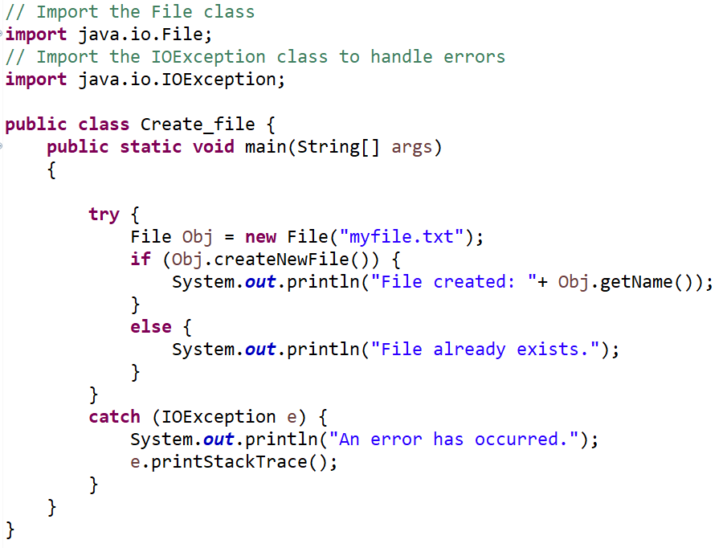

Slide 54
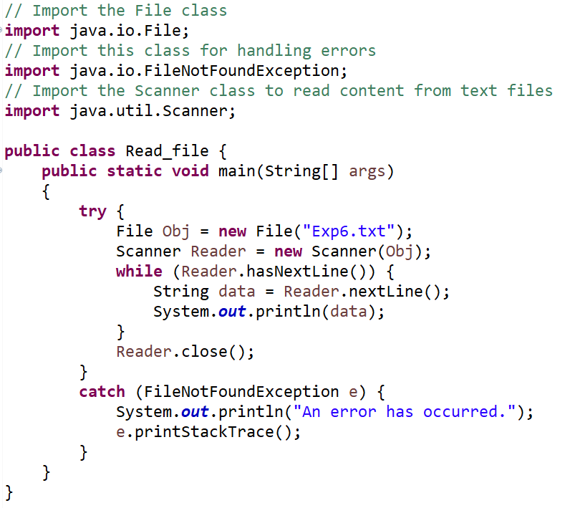
Read from a File

Slide 55
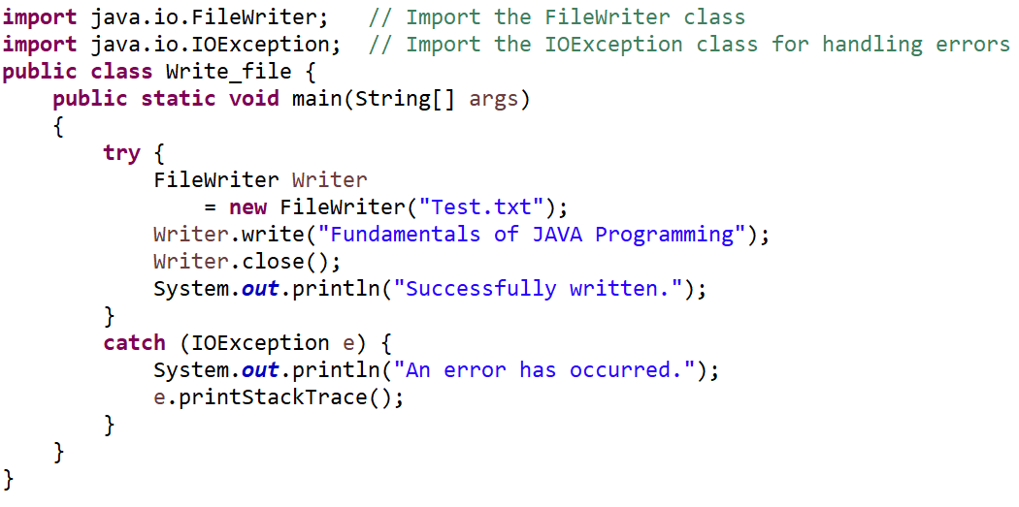
Write to a File
Use of FileWriter class along with its write() method in order to write some text to the file.

Slide 56
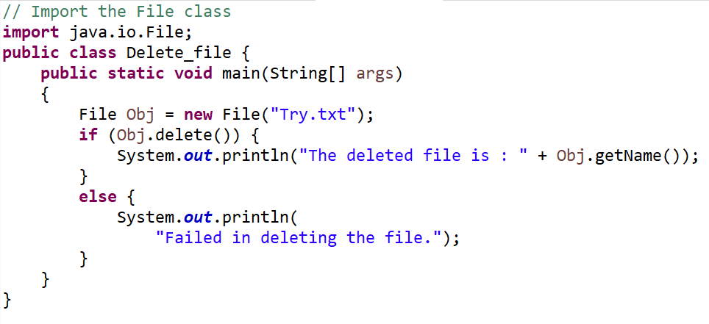
Delete a File
Use of delete() method in order to delete a file

Slide 57
Random Access Files in Java
The class RandomAccessFile is used for reading and writing to random access file.
A random-access file behaves like a large array of bytes.
There is a cursor implied to the array called file pointer, by moving the cursor to read write operations.
If end-of-file is reached before the desired number of byte has been read than EOFException is thrown.
It is a type of IOException.

Slide 58
Constructor
Constructor | Description
RandomAccessFile (File file, String mode) | Creates a random access file stream to read from, and optionally to write to, the file specified by the File argument.
RandomAccessFile (String name, String mode) | Creates a random access file stream to read from, and optionally to write to, a file with the specified name.

Slide 59
Methods
Modifier and Type | Method | Method
void | close() | It closes this random access file stream and releases any system resources associated with the stream.
FileChannel | getChannel() | It returns the unique FileChannel object associated with this file.
int | readInt() | It reads a signed 32-bit integer from this file.
String | readUTF() | It reads in a string from this file.
void | seek(long pos) | It sets the file-pointer offset, measured from the beginning of this file, at which the next read or write occurs.
void | writeDouble (double v) | It converts the double argument to a long using the doubleToLongBits method in class Double, and then writes that long value to the file as an eight-byte quantity, high byte first.
void | writeFloat(float v) | It converts the float argument to an int using the floatToIntBits method in class Float, and then writes that int value to the file as a four-byte quantity, high byte first.
void | write(int b) | It writes the specified byte to this file.
int | read() | It reads a byte of data from this file.
long | length() | It returns the length of this file.
void | seek(long pos) | It sets the file-pointer offset, measured from the beginning of this file, at which the next read or write occurs.

Slide 60
References
E Balagurusamy, “Programming with JAVA”, Tata McGraw Hill, 6th Edition.
Herbert Schildt, “Java: The complete reference”, Tata McGraw Hill, 7th Edition.
https://www.tutorialspoint.com
https://www.geeksforgeeks.org
https://www.javatpoint.com/
Online Resources

